Slide 1





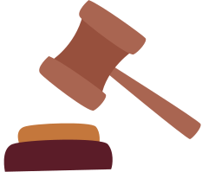


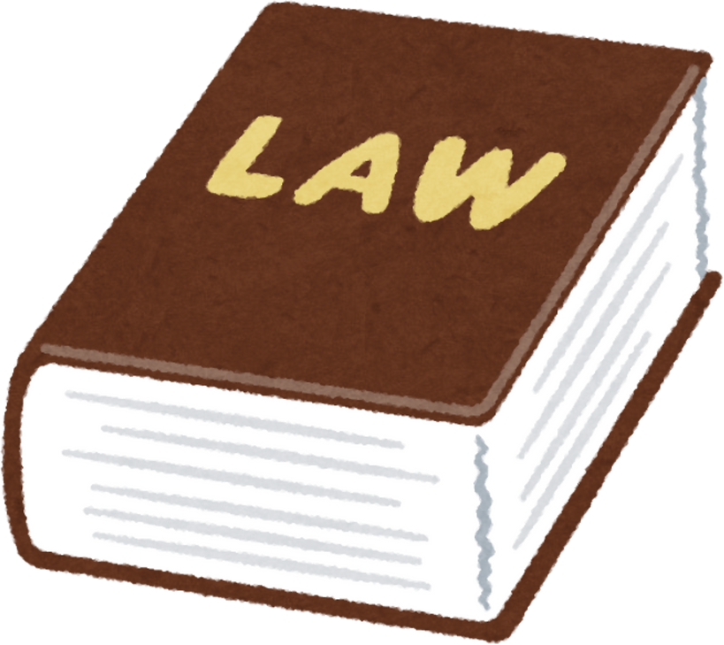
A MULTI-AGENT RAG SYSTEM FOR LEGAL INFORMATION RETRIEVAL IN BANGLADESH
Presented by
MD. SIFAT HAQUE ZIDAN - 2212768042
ABDULLAH AL RAIYAN - 2212712042
RAHIL MEHNAZ - 2121843042

Slide 2

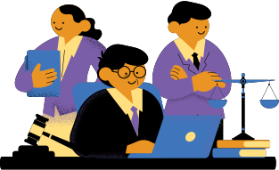
RESULTS & DISCUSSION
  Multi-Agent RAG system successfully deployed for Bangladeshi legal queries
  Evaluated using DeepEval framework & expert human review
  Outperforms GPT-4o-mini and Gemma-3B on accuracy, relevance, and faithfulness

Slide 3
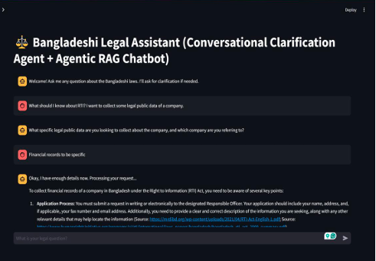
DIAGRAM OF CHATBOT EXAMPLE INTERACTION

Slide 4

Evaluation
  Automated Evaluation: DeepEval (LLM-as-a-Judge)
  Human Evaluation: 2 legal experts (lawyer + law student)
  20 test queries + 15 custom legal questions
  Compared with Vanilla RAG and ChatGPT-4o

Slide 5
Proposed RAG vs. Vanilla RAG (GPT-4o-mini)
  Improvements across 6 of 7 metrics
  +10.1% Faithfulness
  +8.7% Correctness
  −13.5% Hallucination Rate

Slide 6
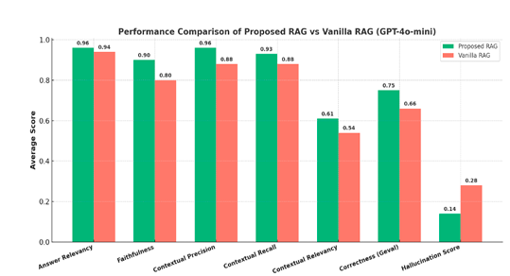
Bar chart comparing both models

Slide 7
Proposed RAG vs. Vanilla RAG (Gemma-3B via Ollama)
  +14.4% Answer Relevancy
  +4.7% Contextual Recall
  −5% Hallucination Rate
  Maintains accuracy on local hardware

Slide 8
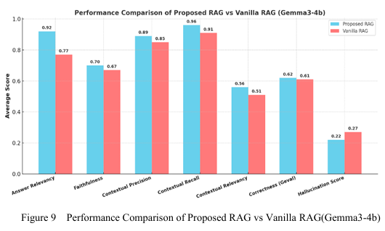
Gemma-3B (Local) Evaluation
Bar chart showing performance comparison

Slide 9
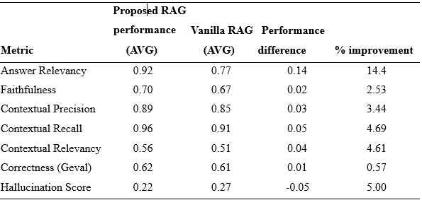
Performance comparison of the proposed RAG system using Gemma34b against the Vanilla RAG using Gemma3-4b.

Slide 10
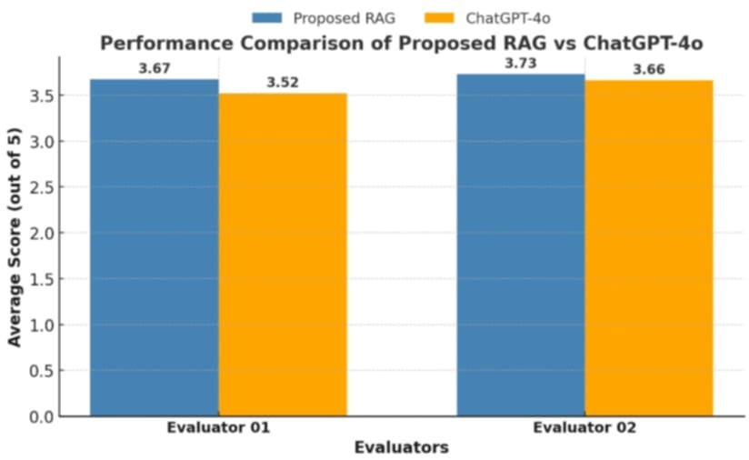
Human Evaluation:
  2 evaluators rated responses (1–5 scale)
  Proposed RAG scored 3.73 & 3.67
  ChatGPT-4o scored 3.60 & 3.52
  ~15% improvement overall

Slide 11
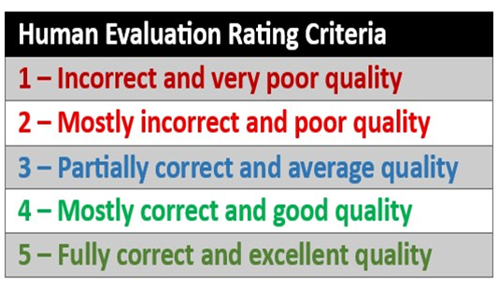
Legal Expert Evaluation Rubric

Slide 12

Expert Feedback
Evaluator 1 (Lawyer):
ChatGPT relied on US laws; Proposed RAG provided Bangladeshi context.
Evaluator 2 (Law Student):
Clarification improves accuracy but simplify legal jargon for users.

Slide 13
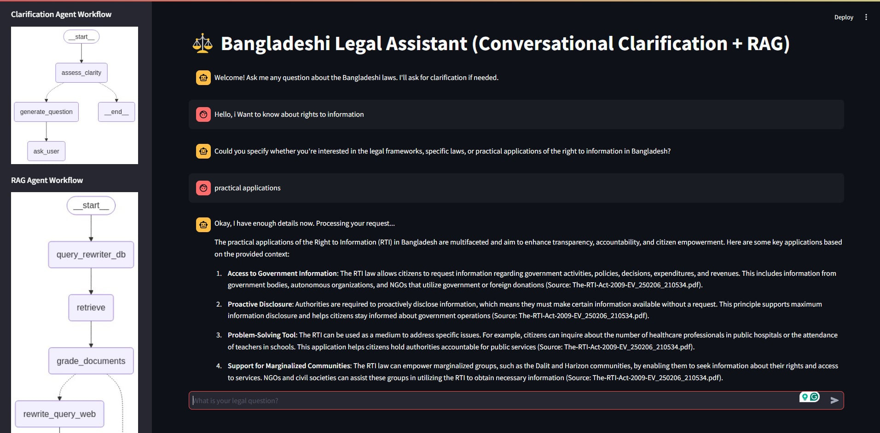

Slide 14
CONCLUSION
A working chatbot was built, tested & validated on both GPT-4o & Gemma3. The evaluation confirms accuracy & relevance.
  Multi-agent architecture
  Clarification + Rewriting + Relevance Grading
  Proven effective across models (cloud & local)
  Reduces risk of misinformation in legal advice

Slide 15


REAL WORLD IMPACT
  Enables accessible, localized legal information
  Reduces cost via Ollama local deployment
  Demonstrates privacy-safe solution for developing regions

Slide 16
THANK
YOU

